Slide 1



An insight into the American Congress

Slide 2
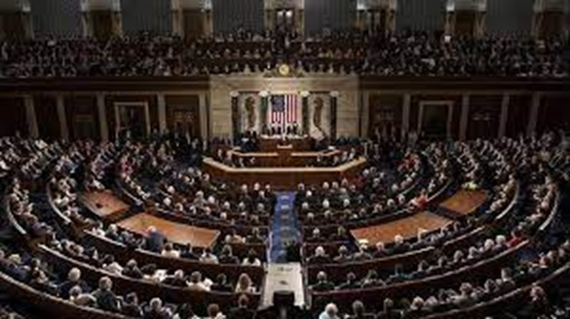
The idea
The American Congress consists of: The Senate – 100 members (two from each 50 states)
The House of Representatives - 435 members
We also consider:
- age
- education
- state
- etc.

Slide 3
Why is it interesting?
Pattern and community detection in a real network
Investigation of how the politicians are connected

Slide 4
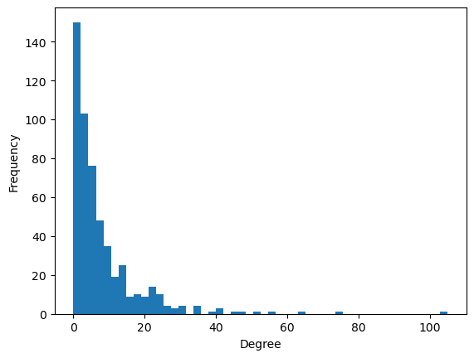
The data
All data is extracted from Wikipedia pages. - Names and attributes of both chambers are available in tables. - Extraction with BeautifulSoup (python package)
The graph:
- Nodes are members of the congress
- Edges will be references in Wikipedia pages
- Attributes will be education, political party etc.
Full directed graph:
534 nodes and 3026 edges

Slide 5


Our project
Methods:
- Community detection
- Pattern detection
- Cluster detection
- NLP of Wikipedia Pages
- Word clouds
02805

